Slide 1
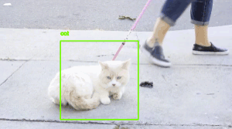
Multiple Object Tracking and Re-Identification
By
Roshan Dhanasiri
Pravin Surawase

Slide 2
Introduction
Multiple Object Tracking (MOT) refers to the process of identifying and tracking objects of interest in a video sequence over time.
Re-Identification (Re-ID) refers to the process of identifying an object in a different location or time, based on its appearance or features
Object tracking is based on object detection, and it is done by the following steps:
Detect the object.
Assign a unique ID to it.
Track the object through the frames:
Last known object’s position (history of the path).
Path estimation (where do we think this object is now, based on new information).
Tracking data is then stored to predict where the object is going, despite occlusions or other digital distractions.
In this presentation will cover the concepts of MOT and Re-ID, the challenges in these techniques, integration of MOT and Re-ID, applications of these techniques.

Slide 3
Challenges in Multiple Object Tracking and Re-Identification
Object Occlusion: When an object is hidden or blocked by another object, which makes its detection and tracking difficult.
Object Appearance Variation: The same object may look different due to different poses, illumination, and other environmental conditions.
Object Motion: When objects move fast, relocate suddenly, or move erratically, making it difficult to track them over time.

Slide 4
Applications
Multiple Object Tracking and Re-Identification have numerous practical applications in various fields.
Autonomous Driving
Used in detecting and tracking other vehicles on the road.
1
2
3
Surveillance and Security
These methods have been used to monitor crowd activities, detect abnormal activities and track suspects in crowded areas.
Retail and Marketing
These methods can be used to track customer activities in stores, resulting in more targeted marketing and improved customer experience.

Slide 5
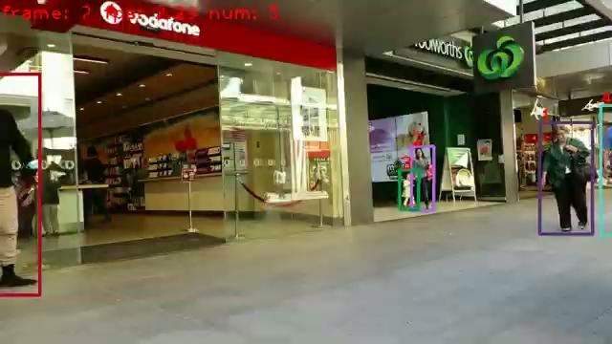
Introduction to BOT-SORT
BoT-SORT is a variant of the SORT (Simple Online and Realtime Tracking) algorithm, which is a widely used multiple object tracking algorithm in computer vision. It is a powerful and effective algorithm for multiple object tracking, and it has demonstrated state-of-the-art performance on various benchmark datasets.
The BoT-SORT tracker is an advanced algorithm designed to address the challenges in multi-object tracking, providing more accurate and robust tracking than its predecessor, the SORT algorithm.
The limitations of the SORT algorithm, such as its sensitivity to missed detections and identity switches, led to the development of the BoT-SORT tracker.

Slide 6
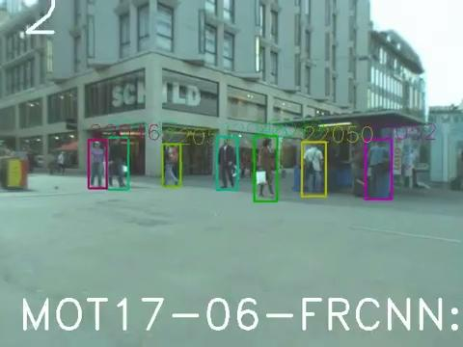
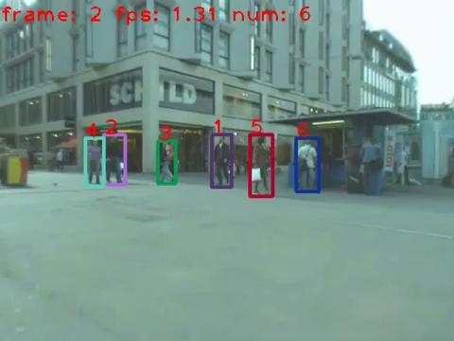
SORT VS BoT-SORT
SORT
BoT-SORT

Slide 7
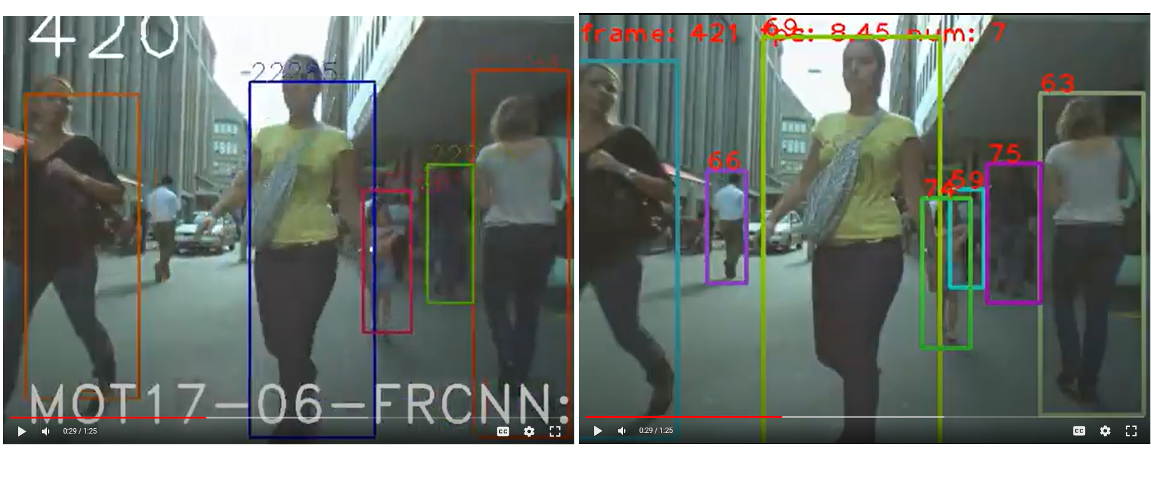
SORT Vs Bot-SORT
SORT
BoT-SORT

Slide 8
BoT-SORT Tracker
The BoT-SORT tracker is an advanced algorithm designed to address the limitations of the Simple Online and Realtime Tracking (SORT) algorithm.
Key features of the BoT-SORT tracker include its ability to handle occlusions, track objects with complex motion patterns, and maintain object identities over time.
The benefits of using the BoT-SORT tracker include improved accuracy and robustness in multi-object tracking applications.
The BoT-SORT tracker has been shown to outperform the SORT algorithm in challenging scenarios such as crowded scenes and fast-moving objects.

Slide 9
Overview of BoT-SORT
DETECTION
Object detection can be performed using pre-trained models such as YOLO_x or Faster R-CNN.
Association
Once the pedestrians are detected and their states are estimated, the association step matches the detected bounding boxes to existing object tracks.
STEP 2
STEP 4
STEP 1
STEP 3
Motion model and state estimation
The Kalman filter-based state estimation is used in the BoT-SORT tracker to predict the next state of each object and estimate its true state.
Application on dataset
MOT-17/ MOT-20 dataset

Slide 10
Object Detection
• Object detection is the first step in the multi-object tracking process.
• Object detection is the process of identifying the presence and location of objects in each frame of the video feed.
• Object detection can be performed using pre-trained models such as YOLO or Faster R-CNN.
• Object detection output includes a list of bounding boxes and their corresponding class labels and confidence scores.
• The bounding box indicates the location of the object in the image or video frame, and the confidence score represents the model's prediction confidence for the detected object.
• The output of object detection is used as input for the next step in the multi-object tracking process, which is object tracking.

Slide 11
Kalman Filter - Introduction
• The Kalman filter-based state estimation is used in the BoT-SORT tracker to predict the next state of each object and estimate its true state.
• The predicted state is the estimated state of the object at the next time step, based on the current state and the motion model.
• The true state is the actual state of the object, which is not directly observable and must be estimated from the noisy measurements.
• The Kalman filter is especially useful for tracking moving objects in dynamic environments, where the object's motion is not well-defined or predictable.
• The Kalman filter is implemented in the BoT-SORT tracker as part of the object tracking process.
• The Kalman filter-based state estimation helps improve the accuracy and robustness of the object tracking in the BoT-SORT tracker.

Slide 12
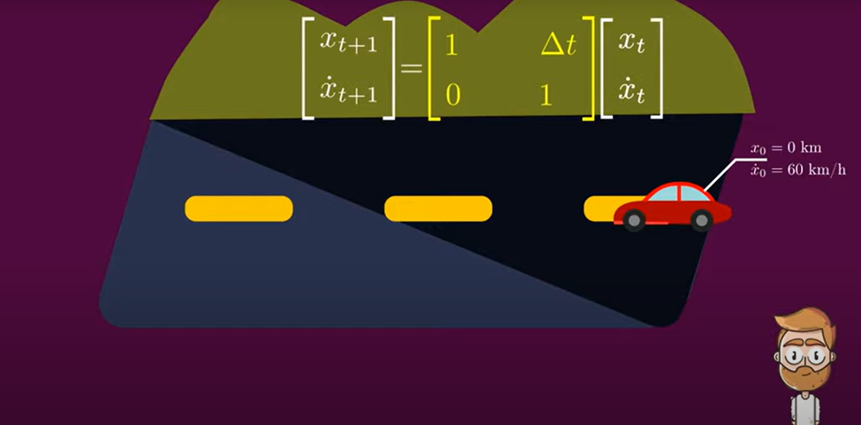
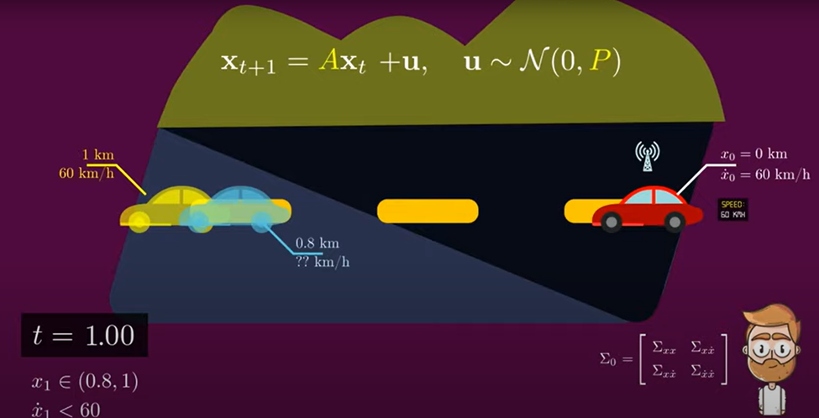
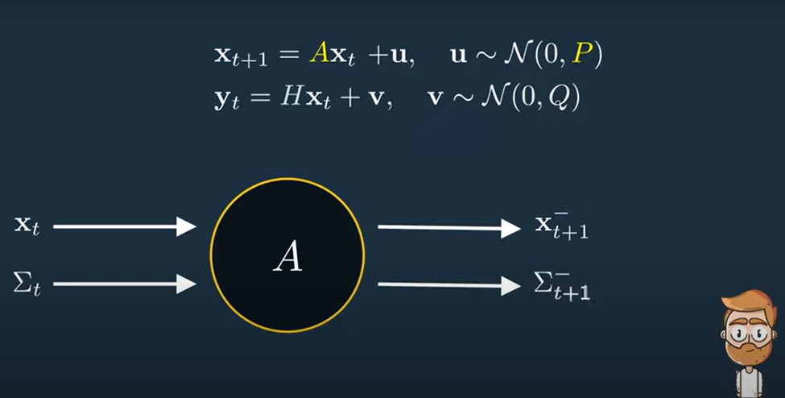
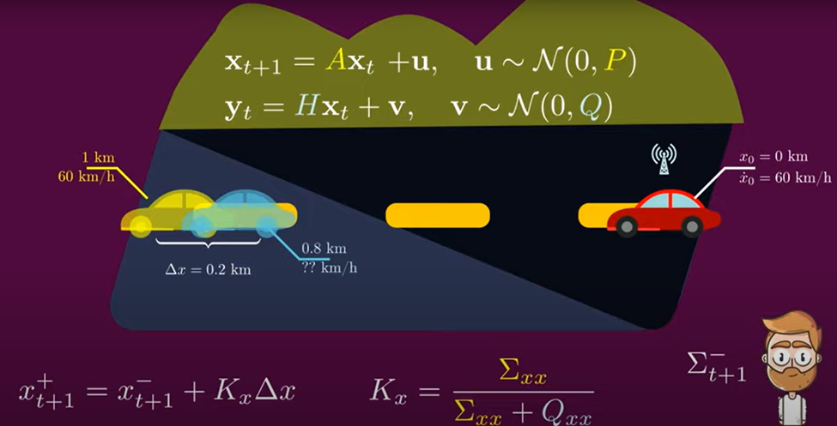
1
1
2
3
4
3
Prediction Step
Update Step

Slide 13
Kalman Filter
• After the Kalman filter predicts the next state of each pedestrian in the Prediction step, it estimates the true state of each pedestrian using a measurement obtained from the object detection step in the Measurement step.
• The Kalman filter then updates the estimated true state of each pedestrian using the Kalman gain and the measurement in the Update step.
• The estimated true state includes the position and velocity of each pedestrian in the current frame.
• The difference between the predicted state and the estimated true state is known as the estimation error.
• The predicted state, estimated true state, and estimation error are typically represented as vectors.
• An example of a predicted state and its corresponding estimated true state for a pedestrian in a video frame might look like (x', y', vx', vy') and (x, y, vx, vy), respectively.

Slide 14
Association - Introduction
Once the pedestrians are detected and their states are estimated, the association step matches the detected bounding boxes to existing object tracks.
• The goal of the association step is to match each detected bounding box to the correct pedestrian track.
• The association step can handle missed detections, false positives, and identity switches.
• The BoT-SORT tracker uses the Hungarian algorithm-based association method for its efficiency and effectiveness.
• An example of the association result for a pedestrian in a video frame might look like this: (1, 2), where the first number indicates the pedestrian ID and the second number indicates the detection ID.

Slide 15
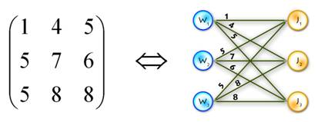
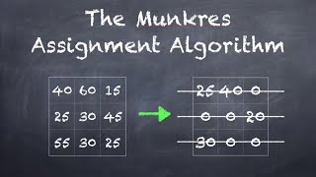
Association - Hungarian Algorithm
• The Hungarian algorithm is a widely used optimization algorithm for solving the assignment problem, which involves assigning objects to targets based on some cost or distance metric.
• In the context of multi-object tracking, the assignment problem is to match the detected bounding boxes to existing object tracks based on their spatial and temporal proximity.
• The Hungarian algorithm is a greedy algorithm that iteratively selects the optimal assignments between the detected bounding boxes and object tracks, based on a cost matrix that encodes the distance or similarity between them.
• The Hungarian algorithm guarantees an optimal solution to the assignment problem, i.e., the solution with the minimum total cost.
• The BoT-SORT tracker uses the Hungarian algorithm for association due to its efficiency and effectiveness in handling the complex and dynamic scenarios of multi-object tracking.

Slide 16
Association - Example
• An example of the association step might involve a scenario where multiple pedestrians are detected in a video frame, and some of them are already being tracked.
• The association step aims to match the newly detected pedestrians to the existing pedestrian tracks and assign the correct identity to each pedestrian.
• The Hungarian algorithm computes the pairwise cost between each detected pedestrian and each existing pedestrian track, based on their spatial and temporal proximity.
• The Hungarian algorithm then selects the optimal assignments that minimize the total cost.
• The optimal assignments correspond to the correct identity assignments between the detected pedestrians and the existing pedestrian tracks.

Slide 17
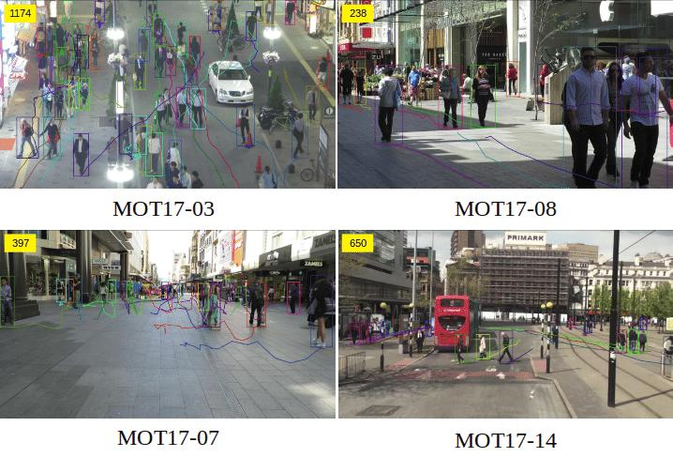
MOT-17 Dataset
• The dataset consists of 14 realistic video sequences recorded from various environments such as crowded streets, indoor scenes, and sports arenas.
• The sequences contain a total of over 25,000 annotated bounding boxes for various object classes such as pedestrians, cars, and bicycles.
• The dataset is widely used in multi-object tracking research, and the results on this dataset are considered to be a standard benchmark for comparison.

Slide 18
Results
MOTA (Multiple Object Tracking Accuracy) measures the overall accuracy of the tracker in correctly tracking objects over time.
MOTP (Multiple Object Tracking Precision) measures the average localization error of the tracker.
ID Switches measures the number of times the tracker incorrectly switches the identity of an object.
HOTA (Higher Order Tracking Accuracy) is a multi-object tracking evaluation metric that takes into account both the object detection and re-identification accuracy, and considers the higher-order association between tracks.
These metrics help in assessing the performance of multi-object tracking algorithms and provide a standardized way to compare different methods.
Tracker | MOTA | MOTP | HOTA | IDF1
BoT-SORT | 64.40 | 89.1 | 61.90 | 71.21

Slide 19
Conclusion
BoT-SORT provides an efficient and effective method for multiple object tracking and re-identification. The use of deep learning models, combined with the Hungarian algorithm for association and HOTA evaluation metrics, allows for high accuracy tracking and re-identification of objects in complex environments.
The implementation of the BoT-SORT on the MOT17 dataset demonstrated its ability to achieve state-of-the-art results in multiple object tracking and re-identification. With its ease of use and high performance, BoT-SORT is a valuable tool for researchers and practitioners working in the field of computer vision and object tracking.

Slide 20
Thank you
Questions?

